Slide 1
Genome annotation
March 5, 2025

Slide 2

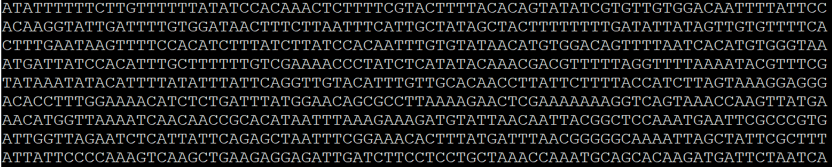
I have an important new isolate assembly…
a FastA assembly is just a bunch of nucleotides, ATCG, awfully boring!
… now what?

Slide 3
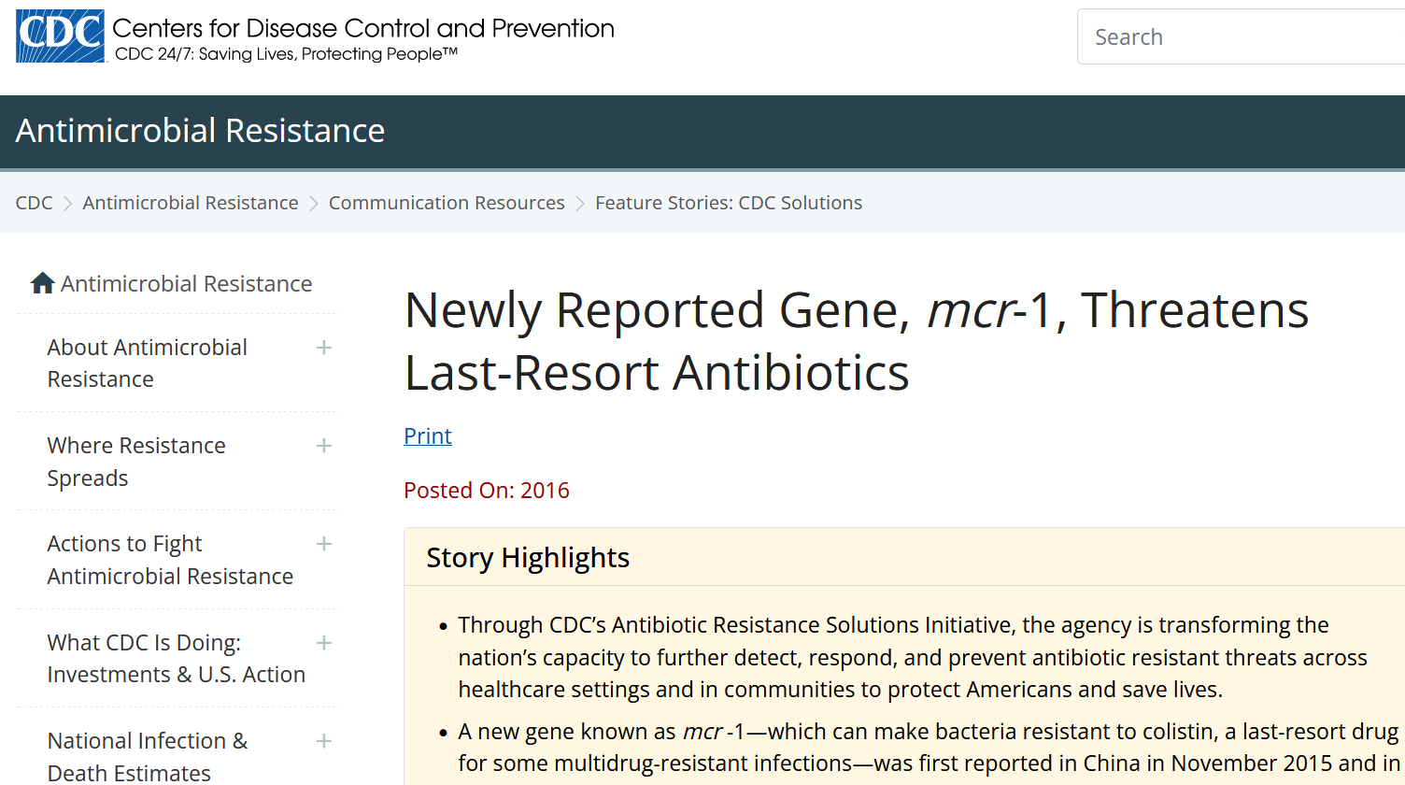
I have an important new isolate assembly…
Examples
An isolate that has resistance to an antibiotic, generally 2 types:
New gene confers resistance
Single base pair (“point”) mutation confers resistance
https://www.cdc.gov/drugresistance/solutions-initiative/stories/gene-reported-mcr.html
Notes:
Full gene resistance is pretty easy to detect with proper annotation tools, whereas point mutations are a whole nother level of accuracy required on the assembly and different tools. Here I’m showing a hot report back in 2016 when the “last resort” antibiotic had a resistance gene develop, that de-activates its utility, reported by CDC. You should be able to identify resistance genes by the end of this lecture.

Slide 4
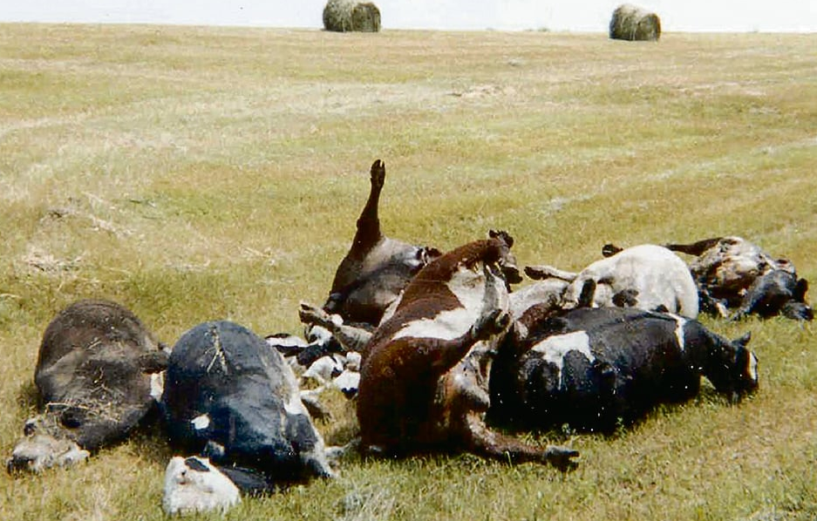
I have an important new isolate assembly…
Examples
An isolate that has makes a toxin
anthrax toxin
Notes:
Another valuable feature of genome assembly is to identify genes that cause illness such as production of toxins. Bacillus anthracis produces anthrax toxin, which is done by 3 genes, which can all be identified with a rapid annotation tool.

Slide 5
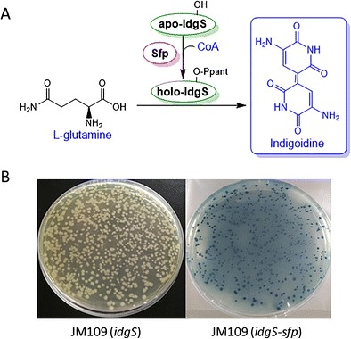
I have an important new isolate assembly…
Examples
A phenotype that makes you want to find the genotype
Biosynthetic pathway (e.g., production of caffeine or secondary metabolites such as antimicrobial compounds)
Indigoidine production makes the bacteria blue
Notes:
Here’s an example where once the gene known to perform this conversion, when cloned into E. coli, shows the bacteria become blue in color. You should also be able to identify some biosynthetic pathways at the end of this lecture.

Slide 6
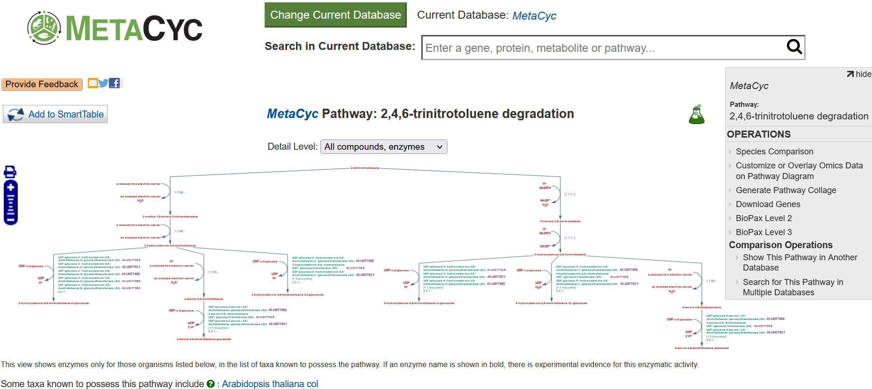
I have an important new isolate assembly…
Examples
A phenotype that makes you want to find the genotype
Biodegradation pathway (e.g., enzymes to breakdown dynamite [TNT])
Notes:
This is a terrific website for pathways – biocyc/metacyc. The compound, enzyme, and cofactors you can’t read here, but the point is larger scale pathways that are well-established, can be search from an annotated assembly. And yes, TNT/dynamite in army soils can be degraded by bacteria. For me, this has been a lot of time-consuming manual one-by-one work identifying genes often not located nearby each other, so I’d often consider this more of an advanced annotation ability. Degrading plastics and PFAS in drinking water are maybe more relevant recent topics of research.

Slide 7

Outline
Sequencing
prediction
annotation
Display
Assembly
Bacillus anthracis
Salmonella enterica
Annotate:
AMR
Biosynthetic gene clusters
General
Visualizations
Some problems we face
Genome annotation pipelines
Hypothesis generation

Slide 8
Bacillus anthracis
Notes:
Let’s start off on the biology today before going into the computation

Slide 9
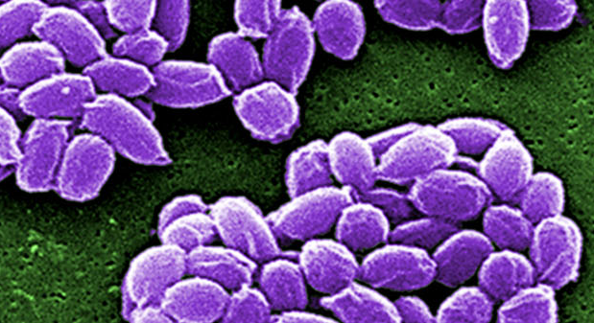

Bacillus anthracis
Bacillus anthracis is a bacterium that makes people sick
“Anthrax can cause severe illness in both humans and animals.”
“Can be treated with antibiotics” and antitoxin
“Most people will never be exposed to anthrax.” “Most human infections with B. anthracis result from handling B. anthracis–infected animals or their carcasses, meat, hides, or wool.”
“People get anthrax by:
breathing in spores,
eating food or drinking water that is contaminated with spores, or
getting spores in a cut or scrape in the skin.”
“Anthrax is not contagious, which means you cannot catch it from another person like the cold or flu.”
https://www.cdc.gov/anthrax/index.html
Notes:
This is a very serious, high-consequence bacterium that can cause disease, so much so that most statements on it I’m directly quoting from CDC’s website.

Slide 10
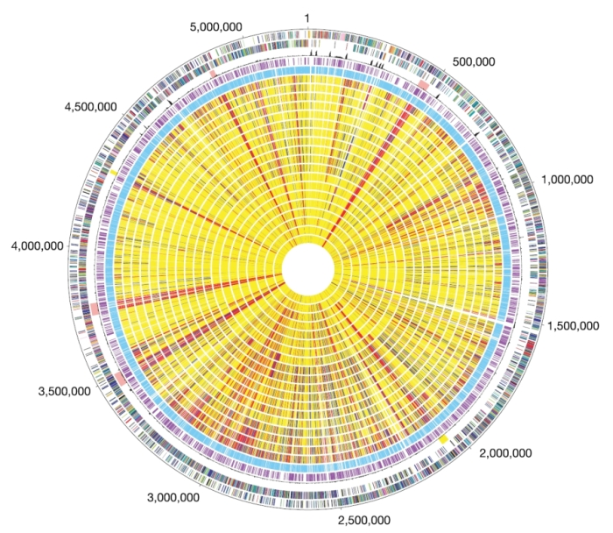
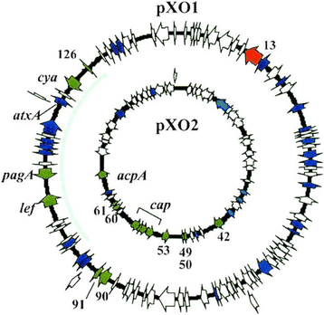
Bacillus anthracis genomics
Gram positive
Chromosome is about 5.2 Mbp
Carries 2 plasmids that hold genes that cause disease
Can have point mutations that code for antimicrobial resistance (AMR)
https://www.nature.com/scitable/content/circular-representation-of-the-b-anthracis-chromosome-38550/ https://www.researchgate.net/figure/The-two-plasmids-pXO1-1816kb-and-pXO2-962kb-required-for-a-fully-pathogenic-B_fig3_309693208
Notes:
https://www.frontiersin.org/articles/10.3389/fcimb.2019.00270/full
https://phil.cdc.gov/Details.aspx?pid=26156
This is my friend and colleague Peyton sequencing a genome in the lab

Slide 11
Salmonella
Notes:
Let’s start off on the biology today before going into the computation

Slide 12
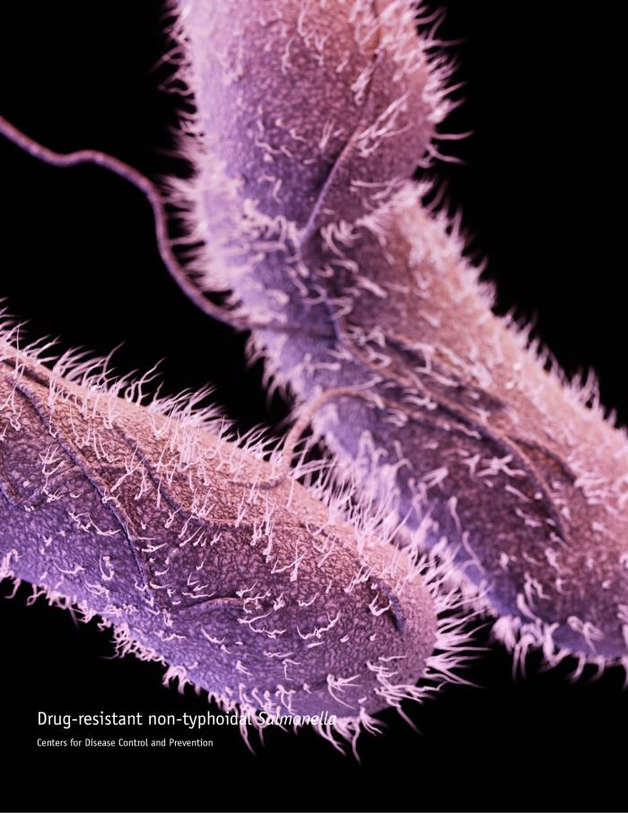
Salmonella
Salmonella are bacteria that make people sick
Typhoid fever or paratyphoid fever, 6 hrs - 7 days after infection
Can be treated with antibiotics
Per year: 1.35 million illnesses, 26,500 hospitalizations, 420 deaths
From food (chicken, sprouts, nut butters, and many others)
person to person
animal to person
https://www.cdc.gov/salmonella/general/index.html

Slide 13
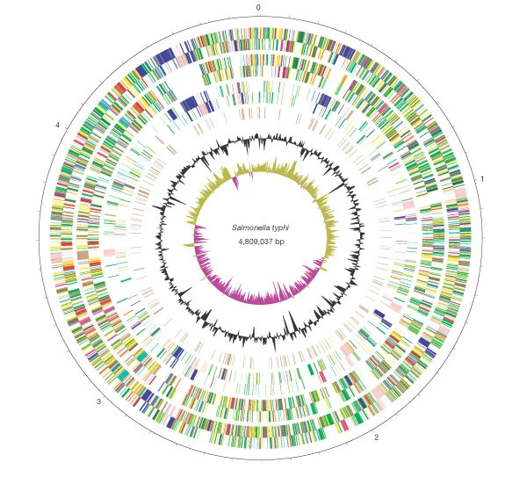
Salmonella enterica genomics
Gram negative
Genome is about 4.7 Mbp
Contains several Salmonella Pathogenicity Islands (SPIs)
SPIs are gene clusters that cause infection and/or disease
Can have genes that code for antimicrobial resistance (AMR)
10+ subspecies
2000+ serotypes (serovars)
https://www.nature.com/articles/35101607/figures/1
Notes:
https://www.frontiersin.org/articles/10.3389/fcimb.2019.00270/full
https://phil.cdc.gov/Details.aspx?pid=26156
This is my friend and colleague Peyton sequencing a genome in the lab

Slide 14
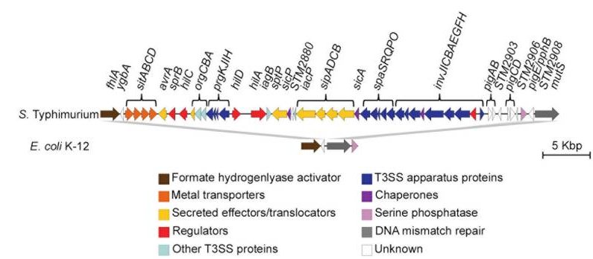
SPI-1 gene cluster
Gene cluster of 40 kb region
Genes are colored by function
How large is this particular SPI-1?
Notes:
https://www.ncbi.nlm.nih.gov/pmc/articles/PMC7232297/
If you find SPI-1, then the genome codes for the T3SS.
Therefore the isolate probably has this function.
(bioinformatics is a predictive science and therefore we wouldn’t really know for sure if it has this function until actually tested for the function)

Slide 15

Antibiotic resistance
National Antimicrobial Resistance Monitoring System (NARMS)
Collaborative nationwide surveillance of antimicrobial resistance by CDC, FDA, and USDA
Enable risk-based decision making
Enable recommendations to public health labs
Notes:
https://www.slideserve.com/cady/national-antimicrobial-resistance-monitoring-system-narms
NARMS – main objectives • Enable risk-based decision making • FDA/CVM relies on NARMS data in deciding whether to approve new antimicrobial drugs for food-producing animals • FDA/CVM relies on NARMS data in deciding whether to withdraw new antimicrobial drugs for food-producing animals • Promote prudent and judicious use of antimicrobials • Prolong the efficacy and useful life of antimicrobials • Identify emerging antimicrobial resistance problems • Guide prescription practices • Encourage standardization of laboratory techniques • Identify areas for more detailed investigation

Slide 16
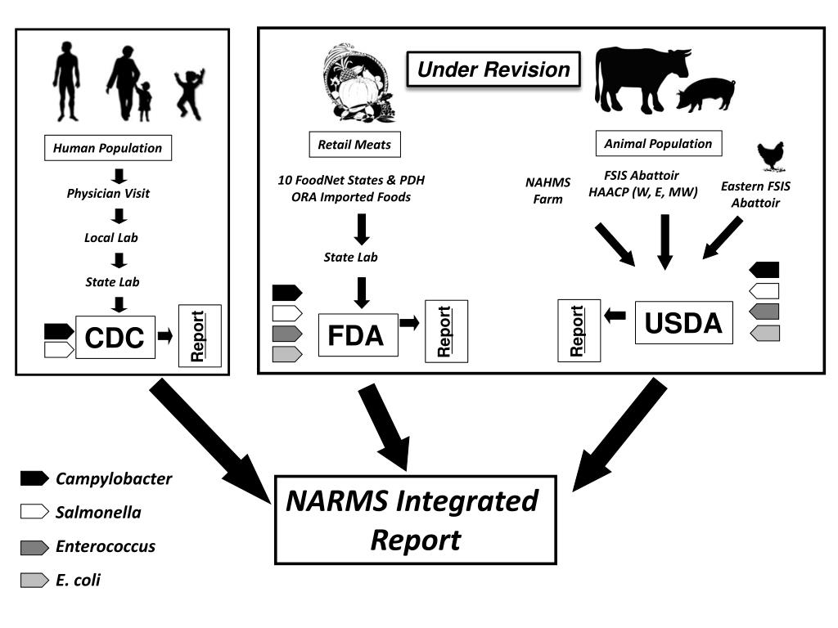
Important trends observed
image from 2014
Notes:
https://www.slideserve.com/jabir/the-national-antimicrobial-resistance-monitoring-system

Slide 17
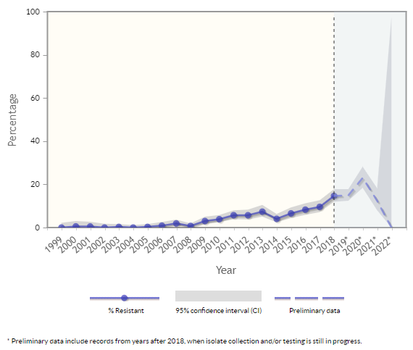
Can view nationwide data on NARMS now
Graph of antimicrobial resistance testing of Salmonella enterica serovar Typhi
1999-2022
ciprofloxacin resistance over time
https://wwwn.cdc.gov/narmsnow/

Slide 18
Let’s annotate for AMR genes

Slide 19
Install Annotation Tools
Setup several environments (avoid conflicts by keeping them separate)
for FastA Bacillus anthracis
$ conda create -n bakta -c conda-forge -c bioconda bakta -y
for FastQ Salmonella enterica
$ conda create -n amrfinder -c conda-forge -c bioconda ncbi-amrfinderplus -y
$ conda create -n prokka -c conda-forge -c bioconda prokka -y
$ conda create -n staramr -c conda-forge -c bioconda staramr -y
Notes:
The first commands with “create” you can use mamba or conda, but all other commands like “activate” should still be conda-only. Remember often copy/pasting into terminal makes non-alphanumerics misinterpreted, so you’ll have to replace these hyphens most likely with a backspace and re-type the hyphen for each to get it to work. Otherwise you’ll get an error like “CondaValueError:.”

Slide 20
Download Bacillus assembled genome (FastA)
$ mkdir -pv ~/fundamentals/annotation
$ cd ~/fundamentals/annotation
# get genome assembly FastA of Bacillus anthracis
$ wget https://ftp.ncbi.nlm.nih.gov/genomes/all/GCF/000/008/445/GCF_000008445.1_ASM844v1/GCF_000008445.1_ASM844v1_genomic.fna.gz
$ gunzip -v GCF_000008445.1_ASM844v1_genomic.fna.gz
$ mv -v \
GCF_000008445.1_ASM844v1_genomic.fna \
Ames_Ancestor.fna
$ grep '>' Ames_Ancestor.fna
>NC_007530.2 Bacillus anthracis str. 'Ames Ancestor', complete sequence
>NC_007322.2 Bacillus anthracis str. 'Ames Ancestor' plasmid pXO1, complete sequence
>NC_007323.3 Bacillus anthracis str. 'Ames Ancestor' plasmid pXO2, complete sequence
Notes:
https://www.ncbi.nlm.nih.gov/datasets/genome/GCF_000008445.1/ is where assembly was deposited in 2004 on NCBI by J. Craig Venter Institute

Slide 21
Download Salmonella assembled genome (FastA)
$ mkdir -pv ~/fundamentals/annotation
$ cd ~/fundamentals/annotation
# get FastA assembly of Salmonella enterica
$ wget https://ftp.ncbi.nlm.nih.gov/genomes/all/GCF/002/091/095/GCF_002091095.1_ASM209109v1/GCF_002091095.1_ASM209109v1_genomic.fna.gz
$ gunzip -v GCF_002091095.1_ASM209109v1_genomic.fna.gz
$ mv -v \
GCF_002091095.1_ASM209109v1_genomic.fna \
R9_3274_R1.fna
$ grep -c '>' R9_3274_R1.fna
# 108 contigs
Notes:
Data come from 2019 manuscript https://journals.asm.org/doi/full/10.1128/mbio.00853-19 This RefSeq accession is now actually suppressed due to contamination, but still is a nice example for AMR genes.

Slide 22

Staramr
Scans bacterial genomes against
ResFinder - database of antimicrobial resistance genes in bacteria
PointFinder - database of point mutations in antimicrobial resistance genes in bacteria
PlasmidFinder - database of plasmids
https://github.com/phac-nml/staramr
From Public health agency of Canada

Slide 23

AMRFinderPlus
Scans bacterial genomes against
AMRFinderPlus Database
The 'core' subset version focuses on acquired or intrinsic AMR gene products including point mutations in a limited set of taxa.
The 'plus' subset include a less-selective set of genes of interest including genes involved in virulence, biocide, heat, metal, and acid resistance.
uses a variety of different search algorithms depending on what you give it (BLAST, HMM, etc.)
searches full genes and point mutations depending on arguments given
https://github.com/ncbi/amr
From US Government (NCBI)

Slide 24
Run staramr
All databases are bundled with the installation
$ mkdir -pv ~/fundamentals/annotation/staramr
$ cd ~/fundamentals/annotation/staramr
$ conda activate staramr
$ staramr \
search \
--pointfinder-organism salmonella \
--pid-threshold 90 \
--percent-length-overlap-resfinder 50 \
--output-dir R9_3274_R1 \
~/fundamentals/annotation/R9_3274_R1.fna
$ column -ts $'\t' R9_3274_R1/detailed_summary.tsv | less -S
Notes:
Staramr is based on resfinder and another database pointfinder. Made by my colleague in public health agency of Canada.

Slide 25
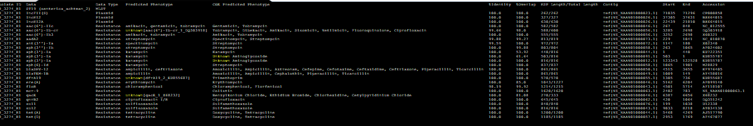
View complete results
column -ts $'\t' R9_3274_R1/detailed_summary.tsv | less -S
You could open the TSV in MS Excel and import, tell it’s delimited by tabs, but here’s a Linux way that can be quicker for just viewing:
column -t adds spaces to make columns in a file
-s $'\t' sets the delimiter to tabs
| called “pipe” means the output from the previous command gets sent over, or “piped” to this one
less is a unix utility that allows you to view a plain textfile without clicking open with in Notepad or MS Excel
-S handles long lines, allows you to use arrows left/right
“q” quits/exits the less screen

Slide 26
View complete results
column -ts $'\t' R9_3274_R1/detailed_summary.tsv | less -S
some results
Sequence type (ST) 19. We might talk more about this later, depending on how far we get in the semester.
Possibly (3) contains different plasmids: IncFII(S), IncHI2, IncHI2A
Resistance to 26 antibiotics: Gentamicin, Tobramycin, Sisomicin, Netilmicin, Fluoroquinolone, Ciprofloxacin, Spectinomycin, Streptomycin, Kanamycin, Amoxicillin, Ampicillin, Aztreonam, Cefotaxime, Ceftazidime, Ceftriaxone, Piperacillin, Ticarcillin, Trimethoprim, Erythromycin, Chloramphenicol, Florfenicol, Colistin, Ciprofloxacin, Sulfamethoxazole, Doxycycline, Tetracycline
Note all genotypic resistances are hypothetical phenotypes
Notes:
Sequencing this Salmonella strain I think showcases the power of genomic annotation. Here we see at least 26 antibiotics would probably be ineffective at helping rid the infection from the patient.

Slide 27
Run AMRFinderPlus
This is yet another tool without a bundled database, so we’ll have to fetch it
$ mkdir -pv ~/fundamentals/annotation/amrfinder
$ cd ~/fundamentals/annotation/amrfinder
$ conda activate amrfinder
$ amrfinder --force_update
$ amrfinder \
--plus \
--output amr.R9_3274_R1.tsv \
--report_all_equal \
--nucleotide_output amr_genes.fasta \
--threads 32 \
--nucleotide ~/fundamentals/annotation/R9_3274_R1.fna
$ column -ts $'\t' amr.R9_3274_R1.tsv | less -S
Notes:
https://github.com/ncbi/amr/wiki

Slide 28
Run AMRFinderPlus
Let’s also specify the organism-specific database “Salmonella”
$ mkdir -pv ~/fundamentals/annotation/amrfinder
$ cd ~/fundamentals/annotation/amrfinder
$ conda activate amrfinder
$ amrfinder --force_update
$ amrfinder \
--plus \
--output amr.Salm.R9_3274_R1.tsv \
--report_all_equal \
--nucleotide_output amr_genes.Salm.fasta \
--threads 32 \
--nucleotide ~/fundamentals/annotation/R9_3274_R1.fna \
--organism Salmonella
$ column -ts $'\t' amr.Salm.R9_3274_R1.tsv | less -S
Notes:
What difference does it make to specify an organism? Sometimes probably no difference, but other times it might add-in specialized resistance info specifically known for the organism.

Slide 29
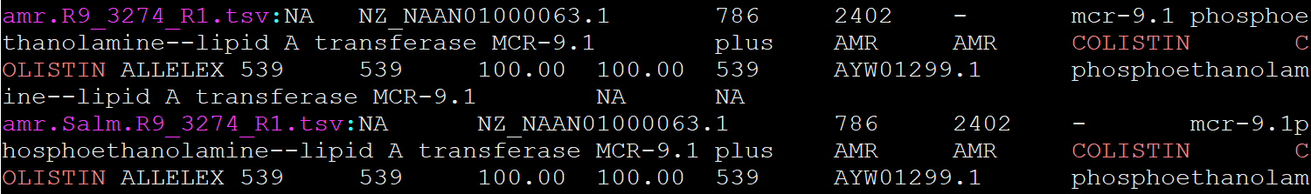
View AMRFinderPlus Results
Is the mcr-9 colistin resistance detected, as previously reported?
$ cd ~/fundamentals/annotation/amrfinder
$ grep -i colistin *.tsv
-i does case Insensitive search (great trick to use when not knowing how it’s spelled)
*.tsv looks at all files that end in tsv. In this case we have 2, and grep nicely lists the filename of each in magenta color for easy tracking
Notes:
What difference does it make to specify an organism? Sometimes probably no difference, but other times it might add-in specialized resistance info specifically known for the organism.

Slide 30
Secondary metabolite - biosynthesis annotation

Slide 31
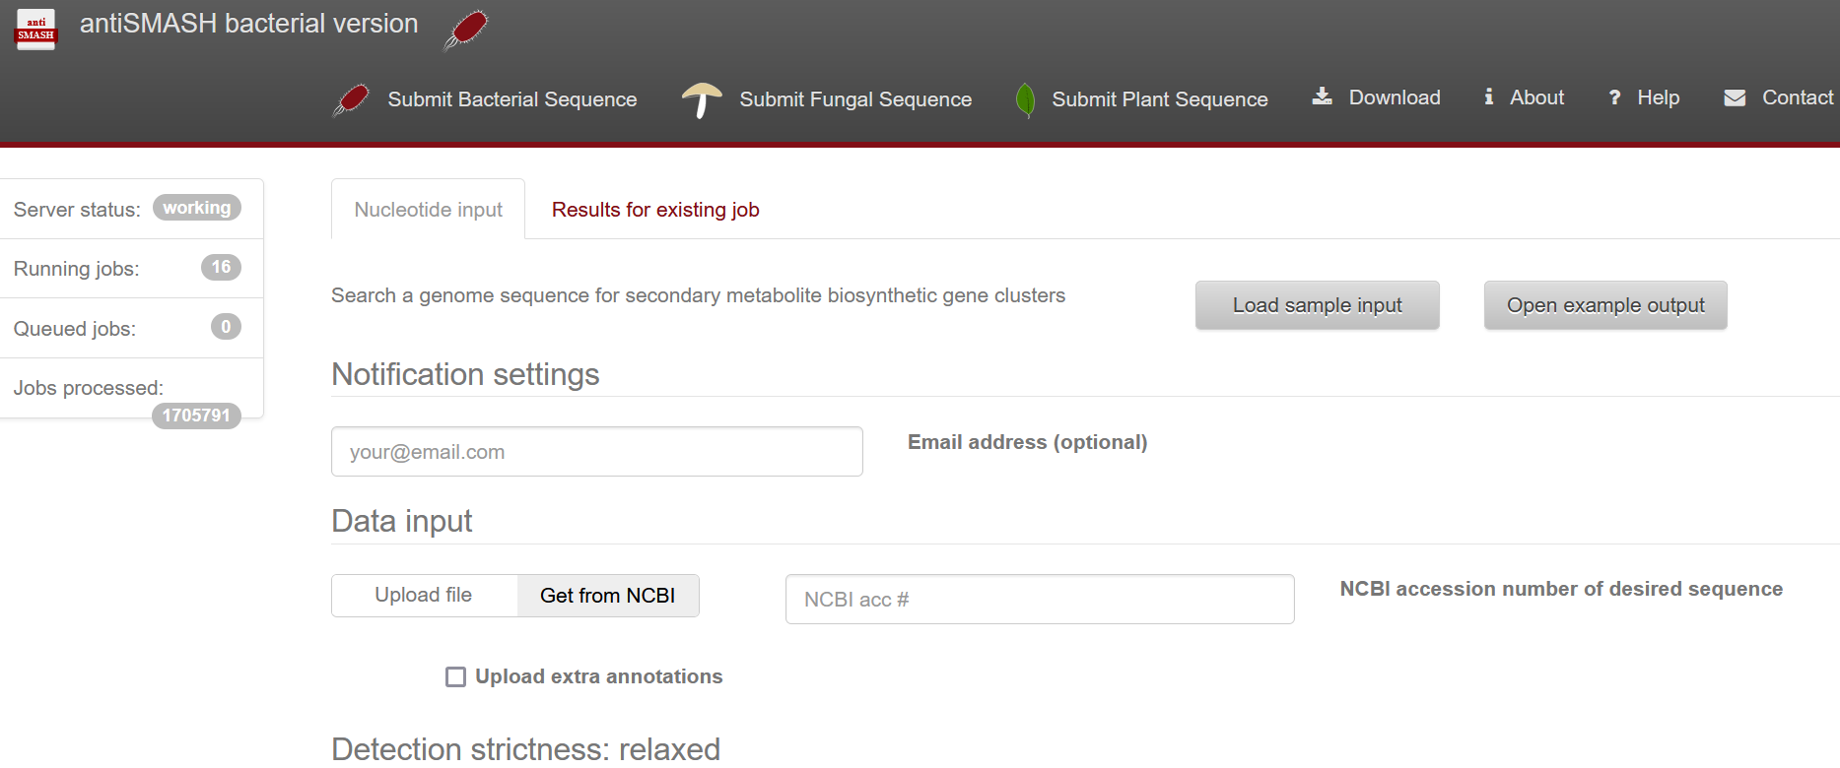
antiSMASH
Web-based, upload FastA or specify NCBI Accession
https://antismash.secondarymetabolites.org/#!/start
Notes:
https://pubmed.ncbi.nlm.nih.gov/37140036/

Slide 32
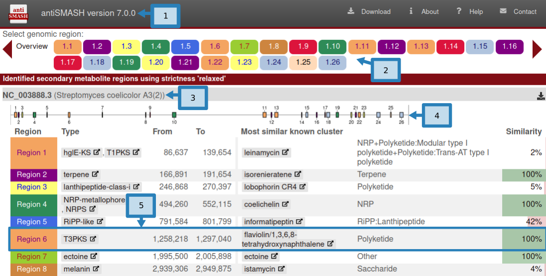
antiSMASH
Graphical results, and textfile results able to download
https://antismash.secondarymetabolites.org/#!/start
Notes:
https://pubmed.ncbi.nlm.nih.gov/37140036/

Slide 33
General annotation

Slide 34
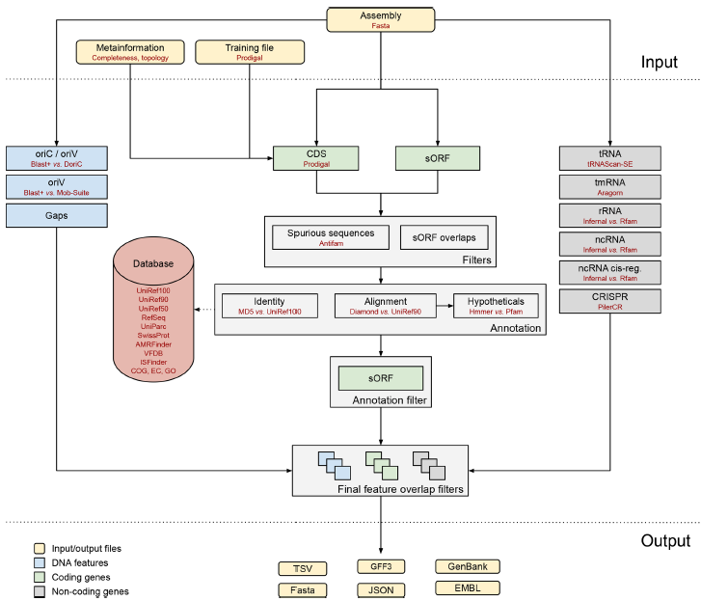
Bakta (2021)
Notes:
Bakta, published in 2021 is the hottest new annotation pipeline https://www.ncbi.nlm.nih.gov/pmc/articles/PMC8743544/

Slide 35
Bakta
The databases are missing from the installation – ugh!
$ cd ~/fundamentals/annotation
$ bakta_db \
download \
--output bakta.db \
--type light
$ bakta \
--output bakta/Ames_Ancestor \
--db bakta.db/db-light \
--compliant \
--genus Bacillus \
--species anthracis \
--strain Ames_Ancestor \
--threads 32 \
~/fundamentals/annotation/Ames_Ancestor.fna

Slide 36
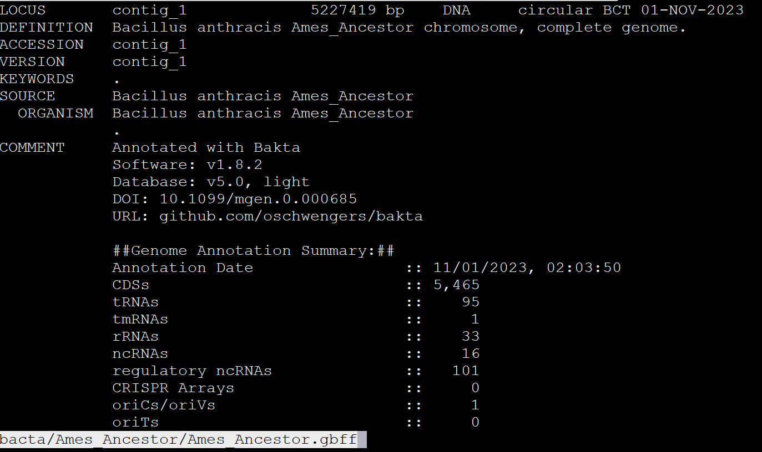
Quickly view Bakta annotated assembly
$ less -S bakta/Ames_Ancestor/Ames_Ancestor.gbff
Notes:
What all do we see here?
Locus name (GAAGDACJ_1), length at the top (1195375bp), date
Features - the genes, etc in the genome
CDS
gene
source
tRNA
misc_RNA
rRNA
hypothetical genes
Salmonella VFs

Slide 37
Search for the lef “lethal factor” gene
$ grep lethal bacta/Ames_Ancestor/Ames_Ancestor.gbff
$ grep lethal bacta/Ames_Ancestor/Ames_Ancestor.gff3
Notes:
What all do we see here?
Locus name (GAAGDACJ_1), length at the top (1195375bp), date
Features - the genes, etc in the genome
CDS
gene
source
tRNA
misc_RNA
rRNA
hypothetical genes
Salmonella VFs

Slide 38
Prokka (2014) – what does it do
Prodigal – predict CDS
RNAmmer – predict rRNA
Aragorn – predict tRNA
SignalP – predict signal leader peptides
Infernal vs RFAM (optional) – noncoding RNA sequences
BLASTp vs custom database – annotations
User-defined (optional)
Uniprot – a database of verified genes
Refseq of just genus
Hidden Markov Model (HMM) searching of profile databases
PFAM
TIGRFAM
Gene Prediction
Gene annotation
Notes:
2014 published https://pubmed.ncbi.nlm.nih.gov/24642063/ signal peptides - control protein secretion and translocation across cell membrane
Infernal vs RFAM database which is a database of RNA families
Uniprot database - curated list of proteins and their functions for use with BLAST
PFAM - curated list of proteins and functions for use with HMMs
TIGRFAM - curated list of proteins and functions for use with HMMs

Slide 39
Prokka
The databases are included with the installation – awesome!
$ cd ~/fundamentals/annotation
$ prokka \
--outdir prokka/Ames_Ancestor \
--compliant \
--genus Bacillus \
--species anthracis \
--strain Ames_Ancestor \
--cpus 32 \
Ames_Ancestor.fna

Slide 40
Prokka
The databases are included with the installation – awesome!
$ cd ~/fundamentals/annotation
$ prokka \
--outdir prokka/R9_3274_R1 \
--compliant \
--genus Salmonella \
--species enterica \
--strain R9_3274_R1 \
--cpus 32 \
R9_3274_R1.fna

Slide 41
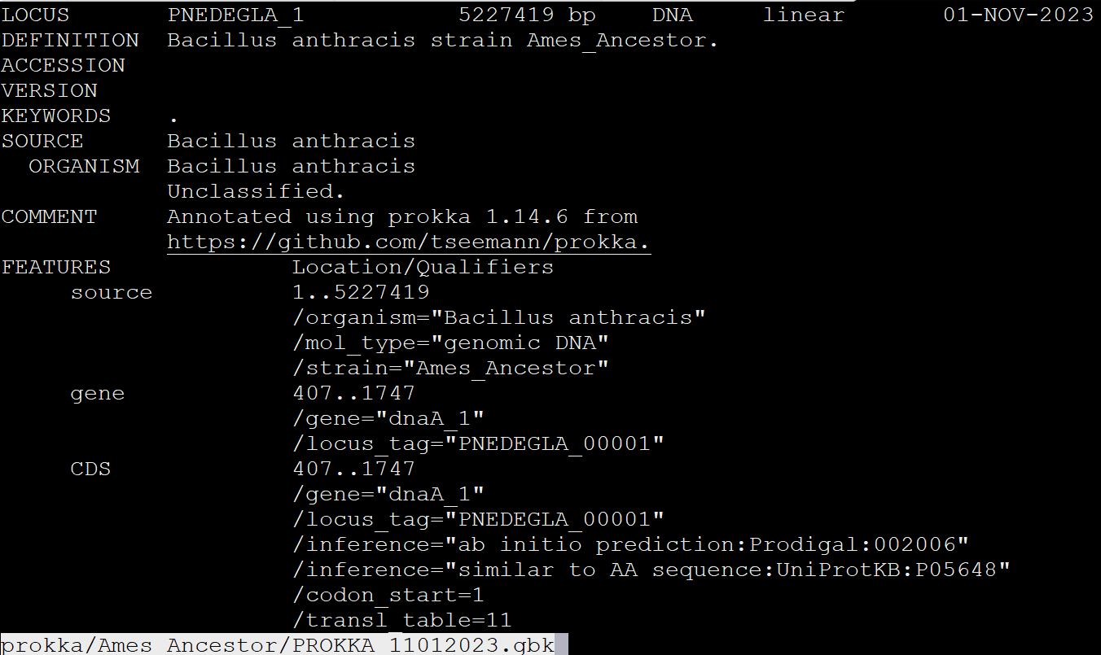
Quickly view Prokka annotated assembly
$ cd ~/fundamentals/annotation
$ less -S prokka/Ames_Ancestor/PROKKA_*.gbk
Notes:
What all do we see here?
Locus name (GAAGDACJ_1), length at the top (1195375bp), date
Features - the genes, etc in the genome
CDS
gene
source
tRNA
misc_RNA
rRNA
hypothetical genes
Salmonella VFs

Slide 42
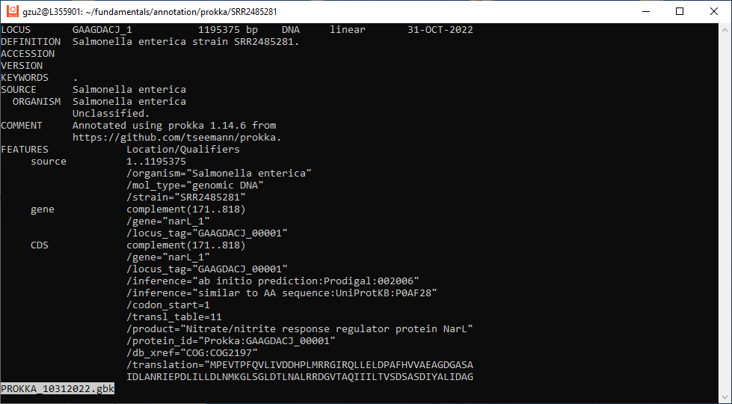
less PROKKA_10312022.gbk
Notes:
What all do we see here?
Locus name (GAAGDACJ_1), length at the top (1195375bp), date
Features - the genes, etc in the genome
CDS
gene
source
tRNA
misc_RNA
rRNA
hypothetical genes
Salmonella VFs

Slide 43
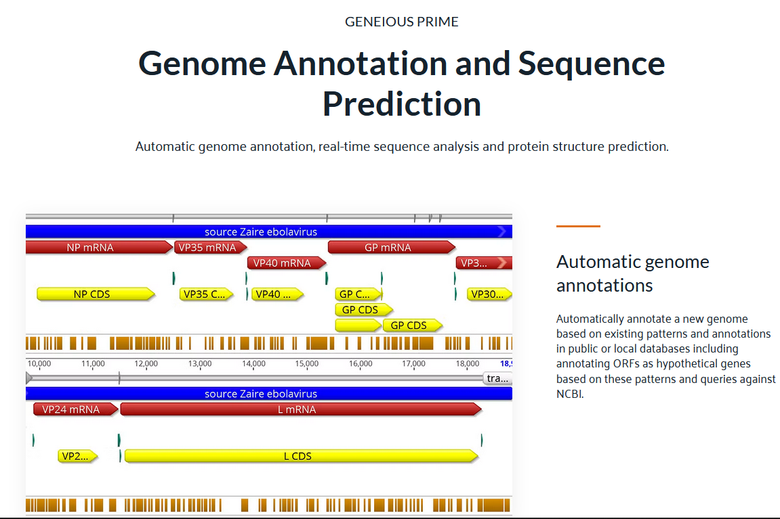
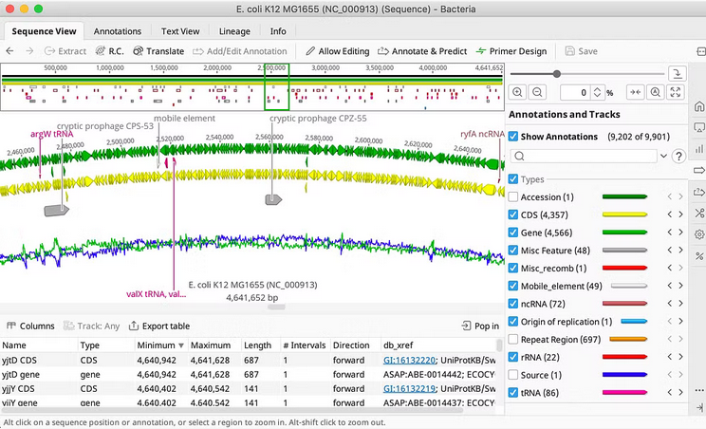
Visualization – Geneious $$$
Gorgeous Mac OS X GUI “feel” to it
You can import the GBK or GFF annotated assembly from bakta or prokka, don’t have to rely on their internal annotation tools
https://www.geneious.com/

Slide 44

Visualize it
Notes:
This is a manuscript’s diagram. What does it look like in IGV?

Slide 45
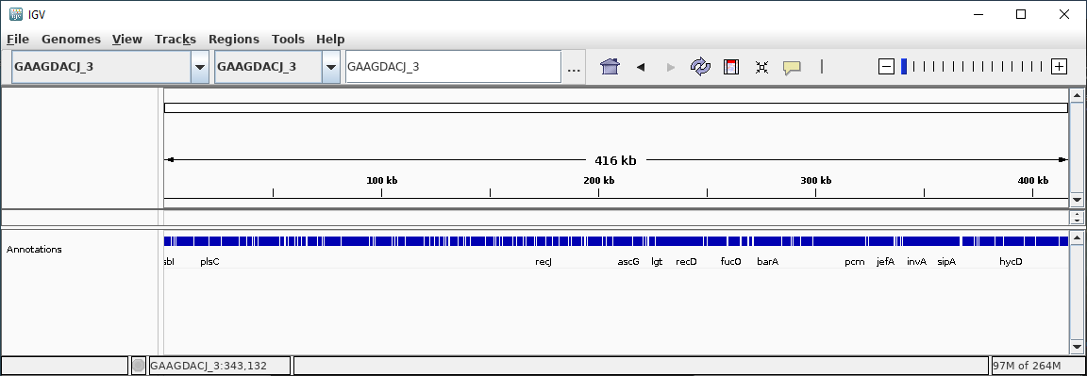
IGV visualization
$ igv --genome PROKKA_10312023.gbk
Notes:
Might have to switch the region. I had to switch to GAAGDACJ_3. Your assembly might be slightly different.

Slide 46
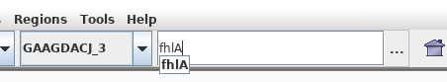
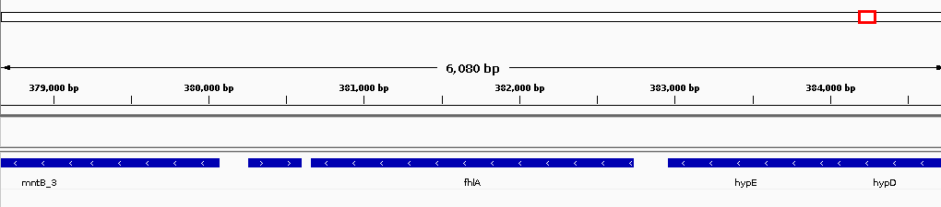
Search for the genes in the gene cluster
starts at about 302,000bp
Search bar gets translated to something like GAAGDACJ_3:378,662-384,740
contig:start-stop
Notes:
But I don’t recognize the genes next to it from that diagram

Slide 47
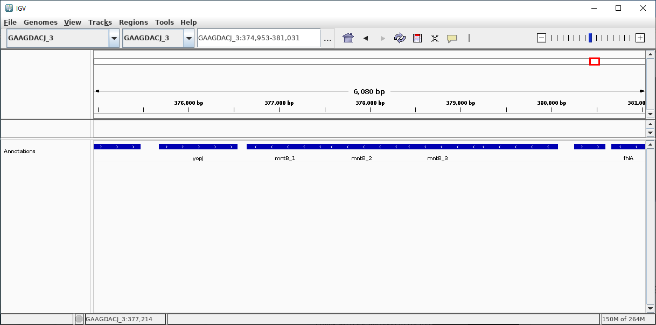
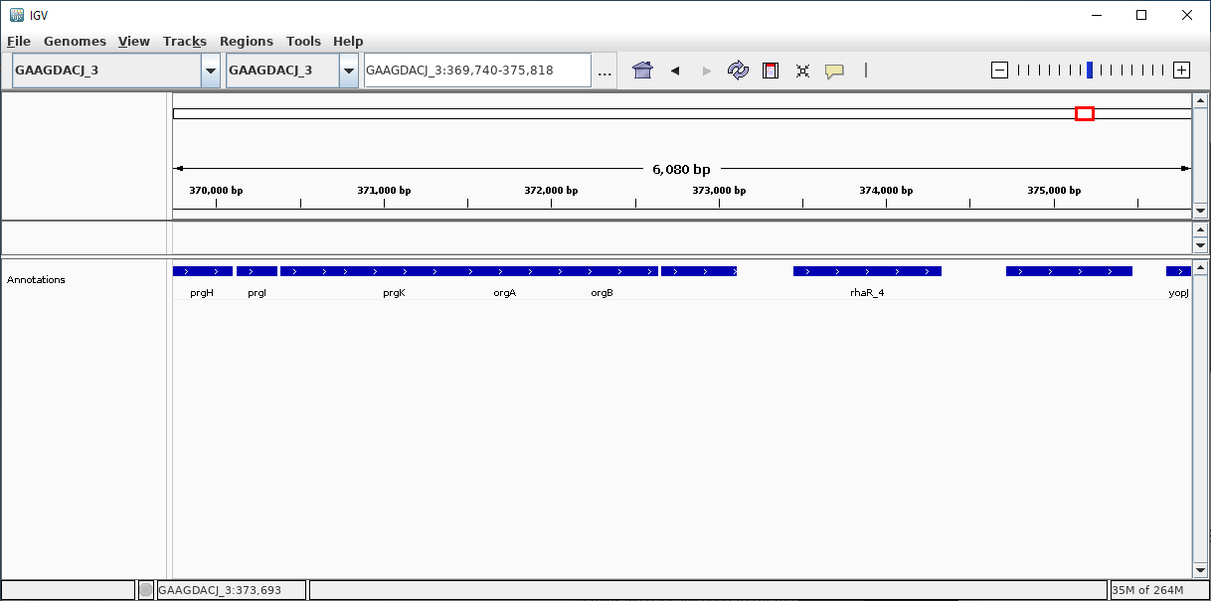
Scroll left

Slide 48
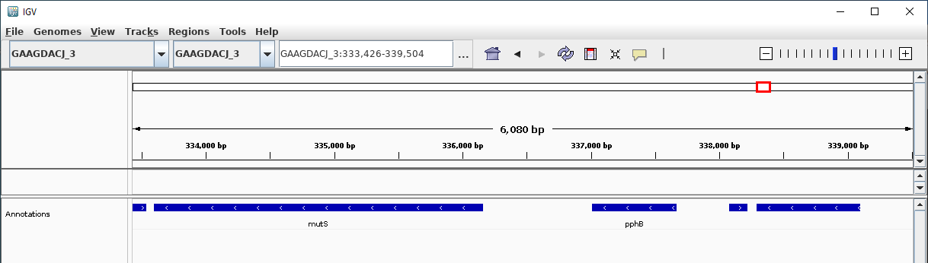
Finally, the end gene is mutS
Ends at about 334,000bp. Started at 302,000bp. How large is this SPI-1? How does that measure against the literature?
Notes:
About 32kb

Slide 49
Conclusions
GenBank (GBK, GB, GBF, GBFF) -vs- Generic Feature Format (GFF, GFF3) the two standard formats.
what makes 1 better than the other?
How to annotate AMR and whole assembly
how to choose a database?
why re-annotate 10 years later?
How to visualize
artists have an important role in bioinformatics
Homework will be on annotating a genome and interpreting results

Slide 50
Professional development

Slide 51
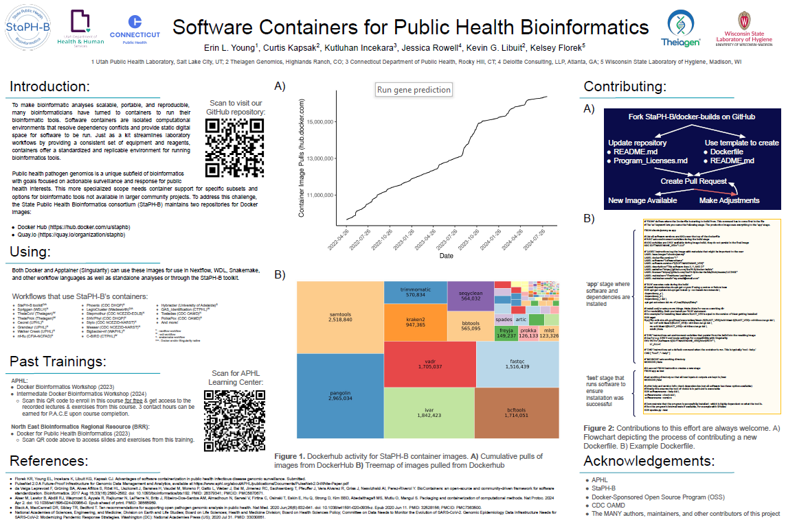

Slide 52
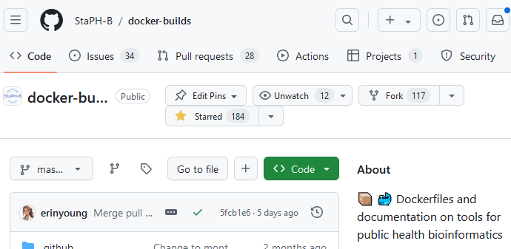
StaPH-B docker-builds github repo

